Slide 1

Presented by
Group 1
CROP YIELD PREDICTION
USING STATISTICS AND MACHINE LEARNING
Sanika Aeer
DevKumar Yadav
Gaurav Bhirwandekar
Rehat Bagga
Aniruddha Ambike
Siddhant Bhagwat

Slide 2



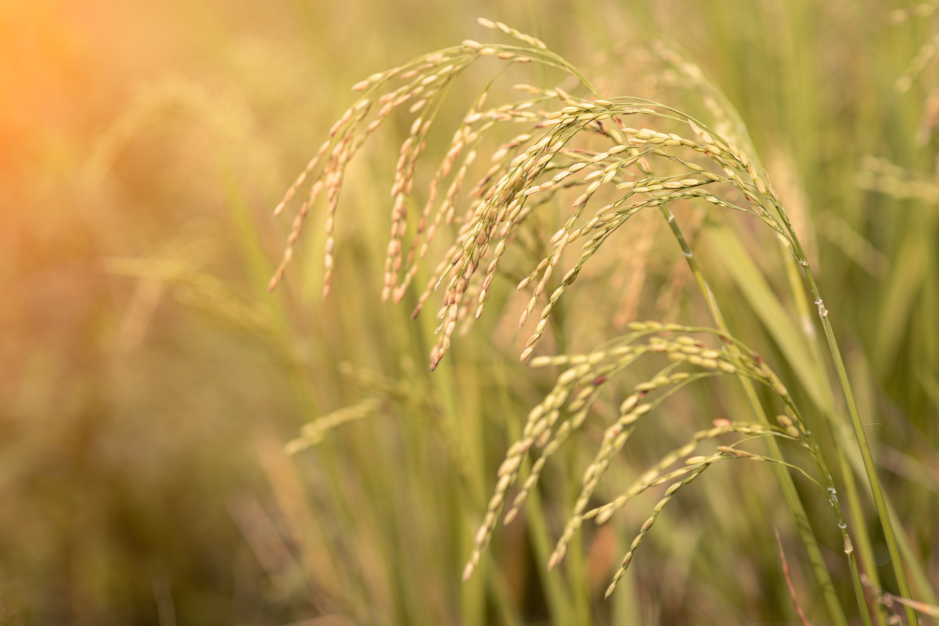
INTRODUCTION
  Agriculture plays a vital role in India's economy and food security.
  Crop yield is influenced by multiple environmental and soil factors such as rainfall, temperature, nutrient levels, and soil pH.
  Predicting crop yield accurately helps farmers make informed decisions regarding crop planning and resource management.

Slide 3
PROBLEM STATEMENT
Traditional crop yield estimation depends on manual observation and experience, which may not always produce reliable results.
  Challenges:
  Changing climatic conditions
  Variation in soil nutrients
  Large amount of agricultural data
  Difficulty in estimating future yield accurately
Need:
A data-driven prediction system that can estimate crop yield based on historical agricultural data.

Slide 4
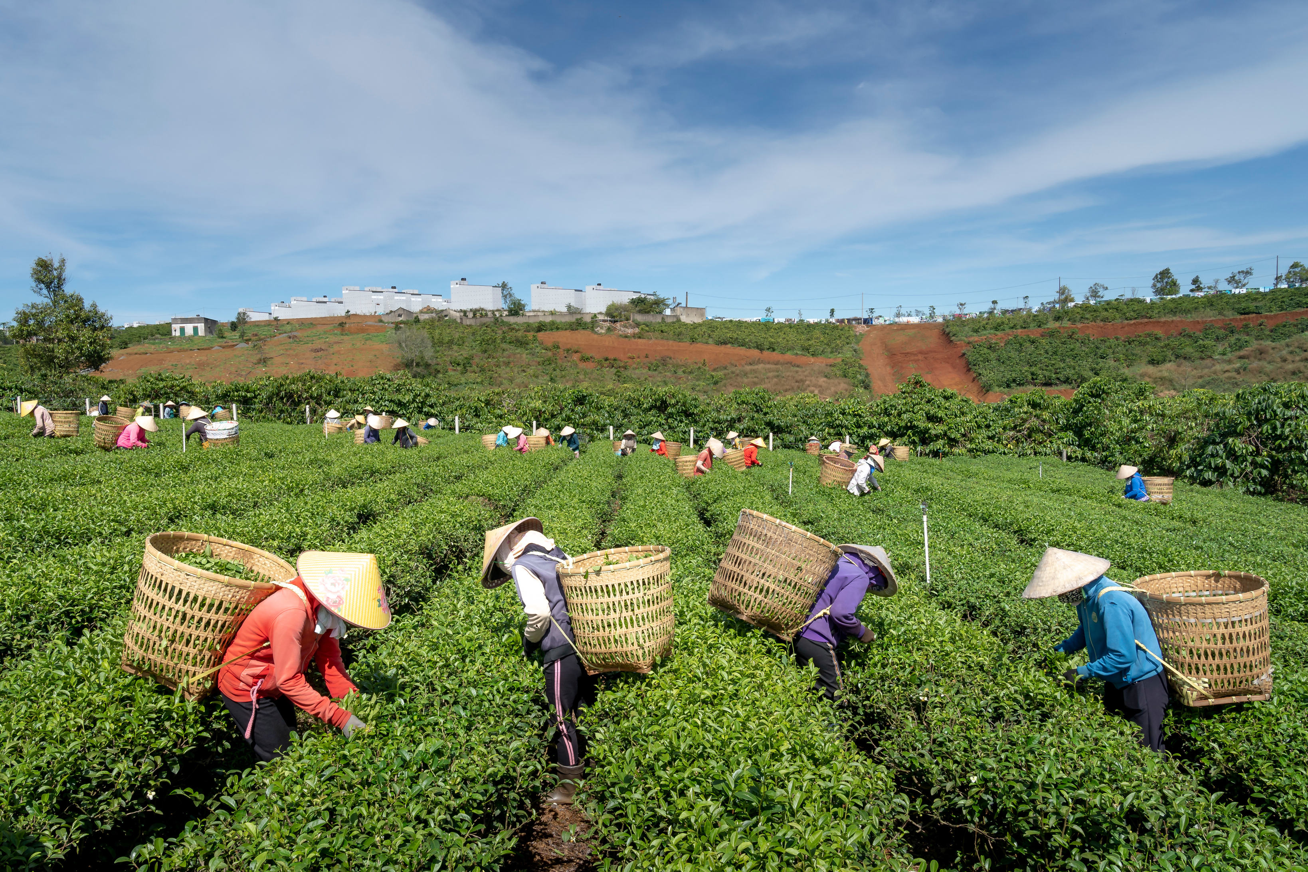
PROPOSED SOLUTION
Our system predicts crop yield using crop-specific Ridge or Random Forest models.
User Inputs
  State
  District
  Crop
  Season
Particular Crop Model Runs
Historical Records are analysed
for that Specific Crop
Selected Model Generates Predicted Yield

Slide 5
FUNCTIONALITY
  The user selects a state, district, crop, season and either Random Forest or Ridge.
  The app shows predicted yield in tonnes per hectare; the detailed report includes history, model metrics and plots.
  Stakeholders: farmers, agronomists, researchers and planners can review estimates.

Slide 6
SYSTEM WORKFLOW
Display Result on UI
User Inputs
Fetch all required
data from dataset
Predict Crop Yield
Clean and Process Data
Run ML Model
Load Specific trained ML model
for the crop selected

Slide 7
IMPLEMENTATION
Prepare data: fill missing values and encode categories.
2. Train a Ridge and a Random Forest model for each crop.
3. Evaluate models with an 80/20 split using MAE, RMSE and R².
4. Predict yield using recent local records and the saved crop model.
5. Display the estimate and detailed report in the Tkinter app.

Slide 8
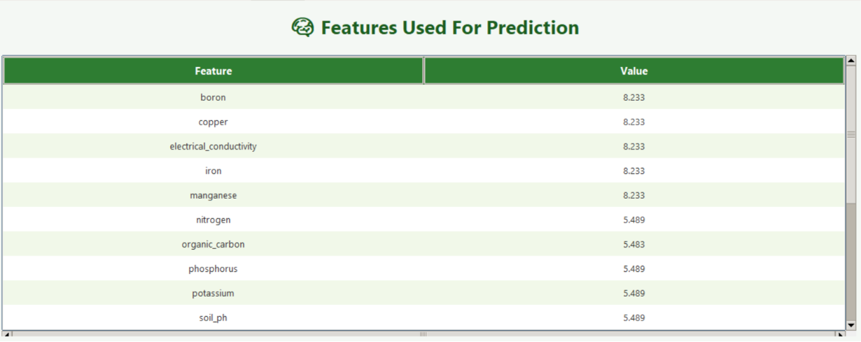
DATASET USED
We merged four datasets to bring the features together
FEATURES
  State
  District
  Crop
  Crop Type
  Season
  Average Rainfall
  Average Temperature
  Boron
  Copper
  Iron
  Nitrogen
  Organic Carbon
  Phosphorus
  Potassium
  Soil pH
  Sulphur
  Zinc
Target Variable : Yield (Tonnes/Hectare)
Project CSV dataset

Slide 9
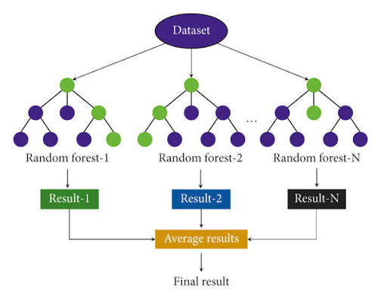
RANDOM FOREST ALGORITHM
09
Why Random Forest?
Random Forest combines many decision trees and averages their yield estimates.
Working :
  Create many decision trees
  Pick Random Features
  Each tree Makes a Prediction
  Combine the Predictions
  Final Result
Parameters Used :
  n_estimators : 300
  max_depth : 20
  min_samples_split : 5
  min_samples_leaf : 2
  random_state : 42

Slide 10
TECHNOLOGIES USED
Programming Language : Python
Libraries : Pandas , NumPy , Scikit-learn
GUI : Tkinter
IDE : VS Code
Dataset Processing : CSV , One-Hot Encoding

Slide 11
RIDGE REGRESSION ALGORITHM (LINEAR MODEL)
09
Why Ridge Regression?
Ridge Regression fits a linear model while shrinking large coefficients to keep predictions stable.
Working :
  Regularized Linear Baseline: Provides a stable benchmark to compare against non‑linear tree models.
  Handles Multicollinearity: Controls high correlation among soil nutrients (N, P, K) and weather variables by penalizing large coefficients.
  Stable & Reliable: Reduces model variance, giving consistent and interpretable yield predictions across different agricultural regions.
Parameters Used :
  Model: RidgeCV
  alphas: [0.05, 0.1, 0.5, 1.0, 5.0, 10.0] (dynamically selects optimal regularization strength)
  Categorical Encoding: One-Hot Encoding for State, District, and Season
  Validation: 80/20 train-test split evaluated on R squared, MAE, and RMSE

Slide 12
LIMITATIONS
Predictions depend on historical data quality and coverage.
  • Requires matching historical records for the selected crop and location
  • Uses recent historical medians rather than live soil and weather measurements
  • Random train/test splitting mixes years and regions, so test results may not reflect future performance
  • The dataset ends in 2020 and may not reflect current farming or climate conditions

Slide 13
LEARNING OUTCOMES
• Prepared crop, soil and weather data for machine learning
• Trained and compared regression models for different crops
• Interpreted MAE, RMSE and R² to assess prediction quality
• Connected saved models to a Tkinter app and understood the limits of historical data

Slide 14
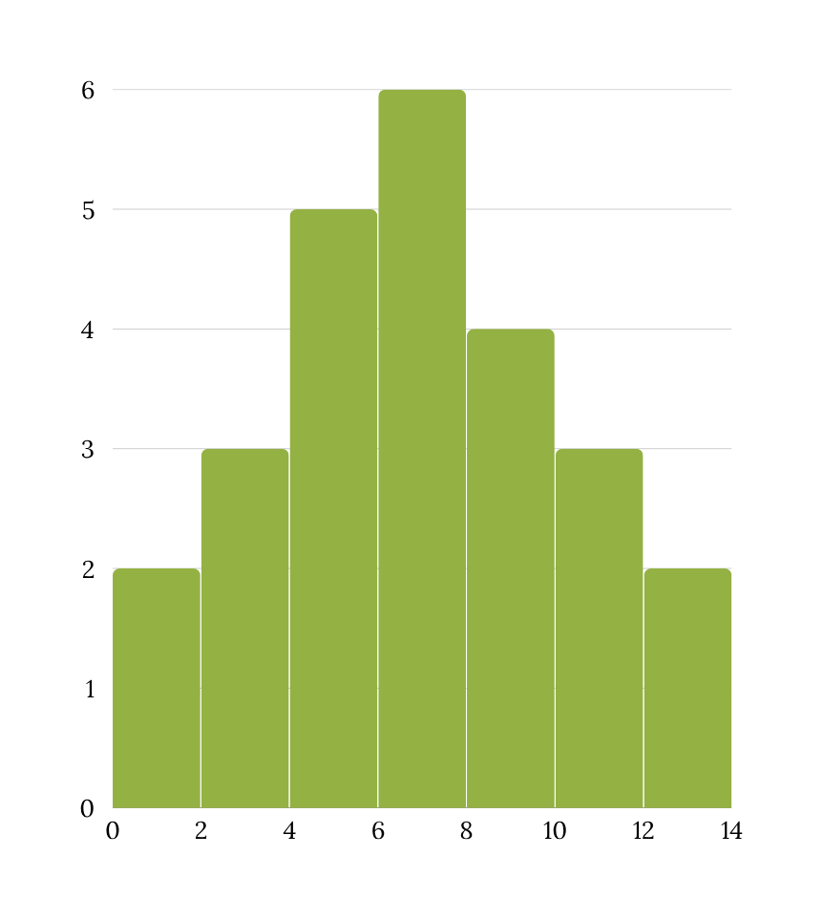
FUTURE SCOPE
Future Enhancements
  Live weather API integration
  Fertilizer recommendation
  Disease prediction
  Mobile Application
  Multi-language support
  Satellite data integration
  Deep Learning models

Slide 15
CONCLUSION
  The system estimates crop yield from historical data using crop-specific Ridge and Random Forest models.
  The Tkinter app shows an estimate and supporting history. Accuracy depends on the selected crop and data coverage.
Outcome
  Crop-specific estimates
  Saved evaluation metrics
  Detailed report
  Decision support for agriculture

Slide 16
REFERENCES
Data.gov.in – Rainfall in India
India Data Portal – Fertilizer Sales Dataset
https://www.data.gov.in/catalog/rainfall-india
https://ckandev.indiadataportal.com/dataset/fertilizer
-sales
Kaggle – Crop Yield in Indian States Dataset
India Data Portal – Climate Data
https://www.kaggle.com/datasets/akshatgupta7/crop-yield-in-indian-states-dataset
https://ckandev.indiadataportal.com/dataset/climate-
data
India Data Portal – Soil Health Card Dataset
https://ckandev.indiadataportal.com/dataset/soil-health-card/resource/024cf507-4281-4c89-a40e-37b5add3a4df

Slide 17
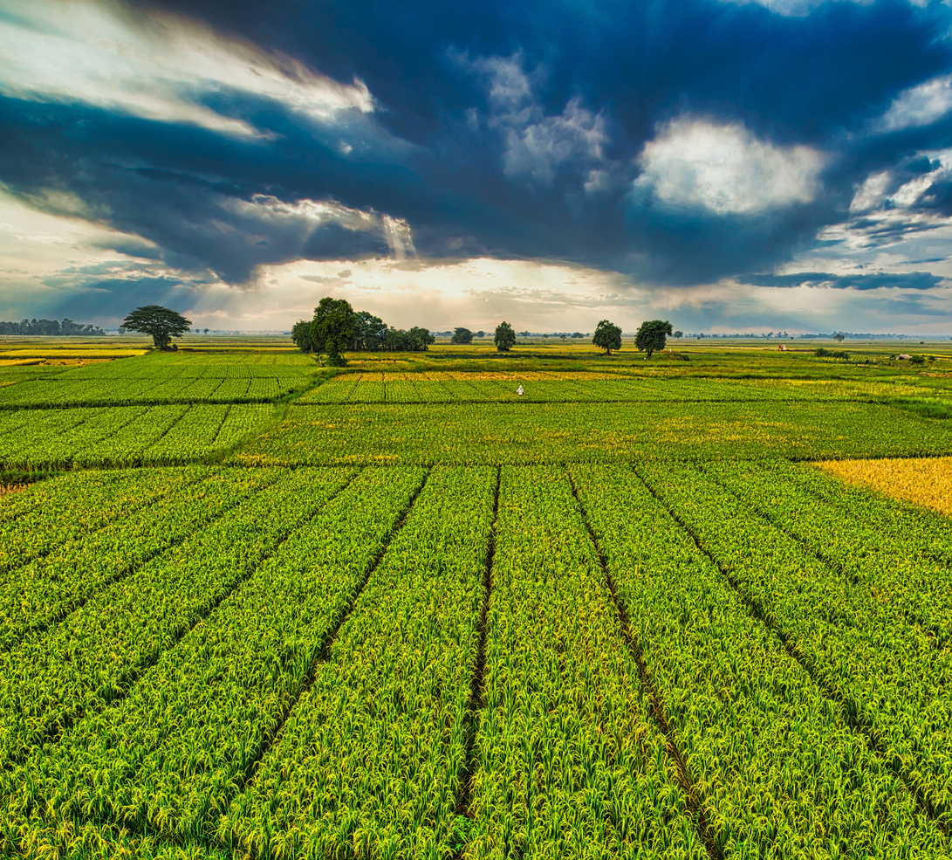
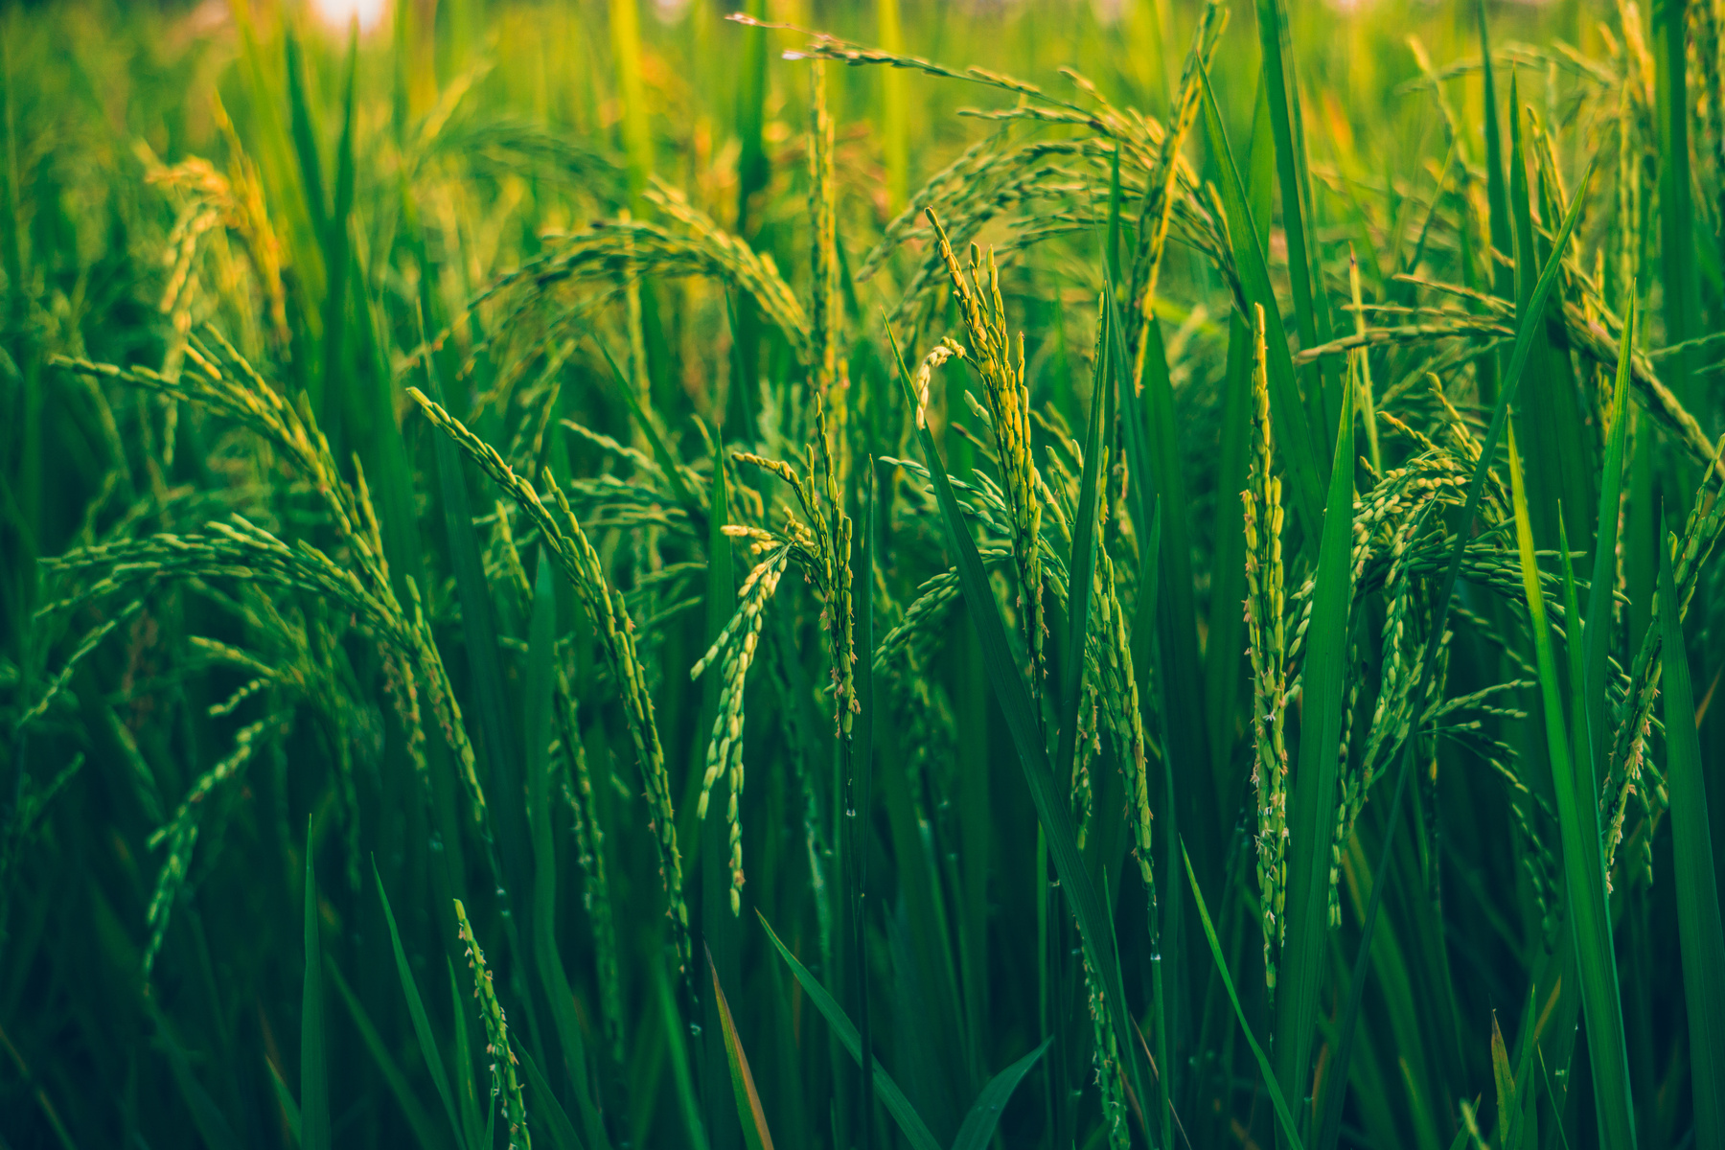
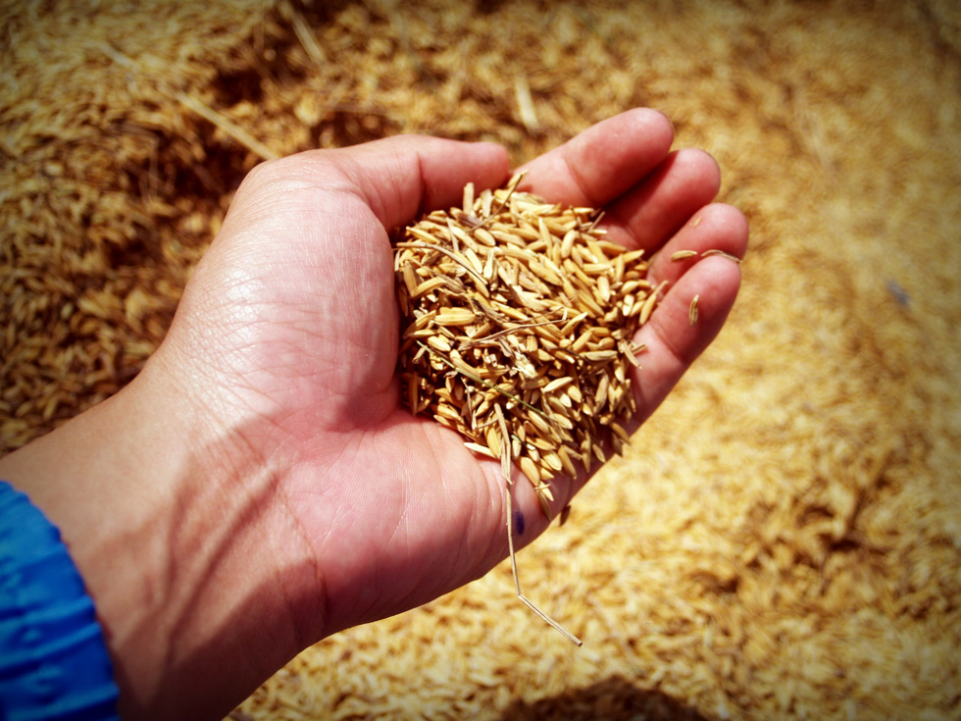
16
Thank You!

